Slide 1


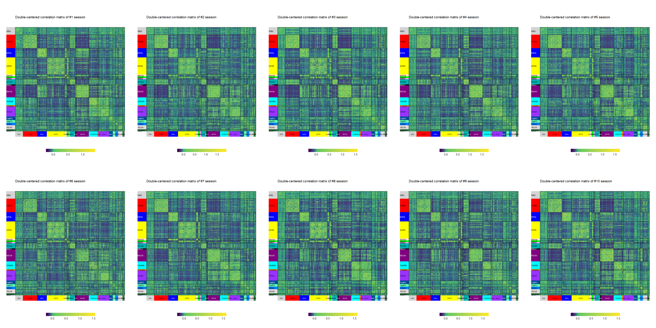
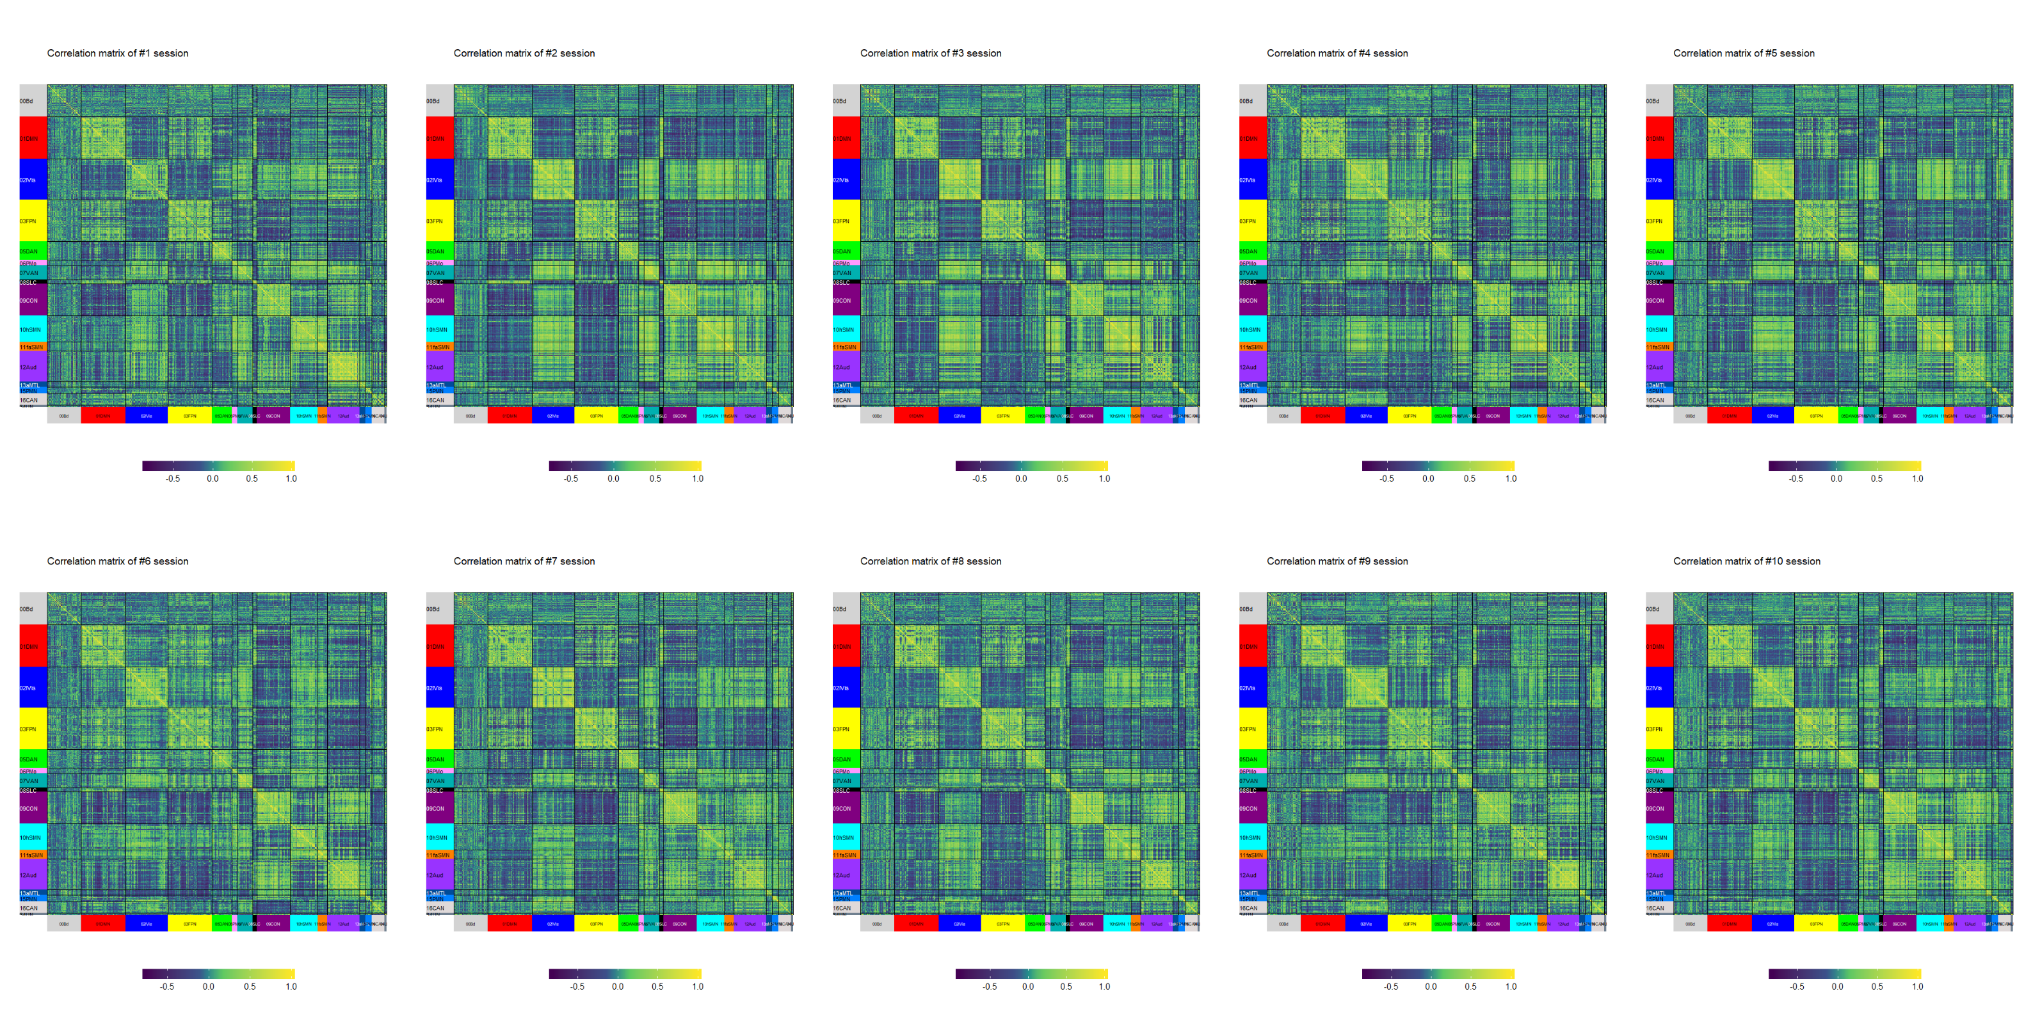
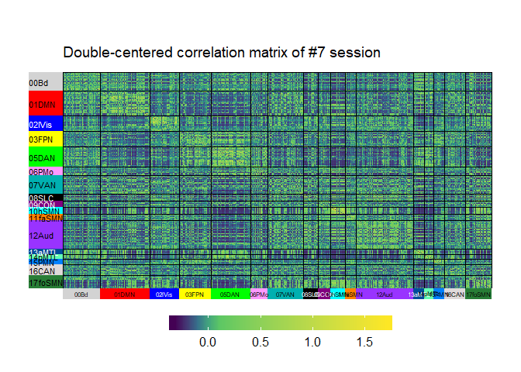
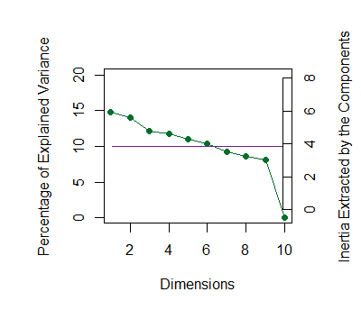
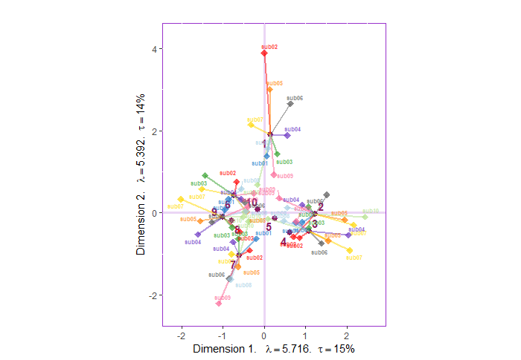
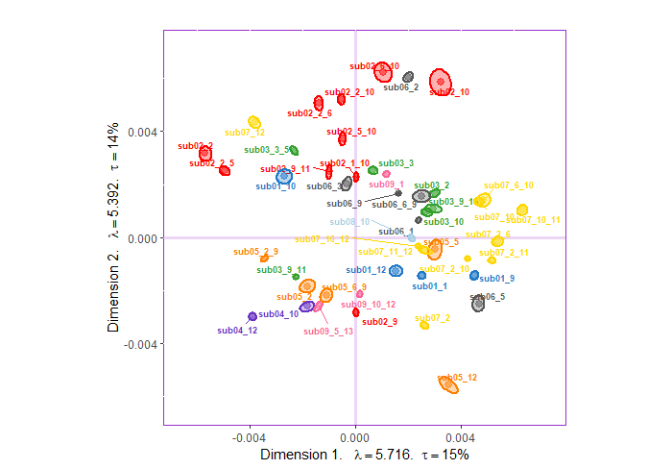
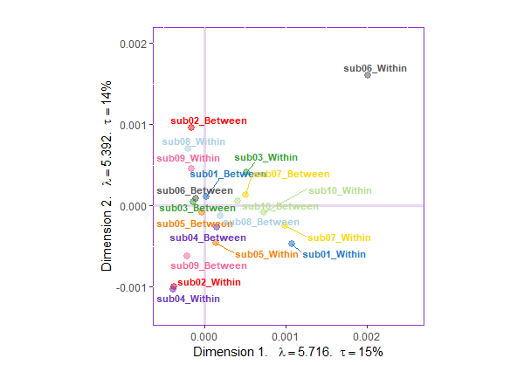
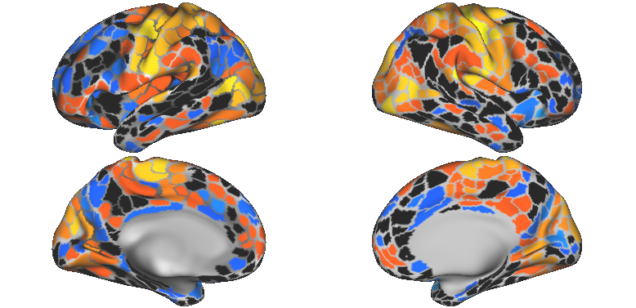
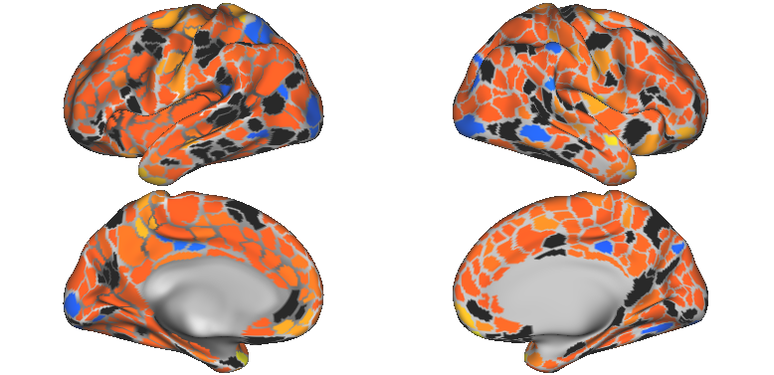
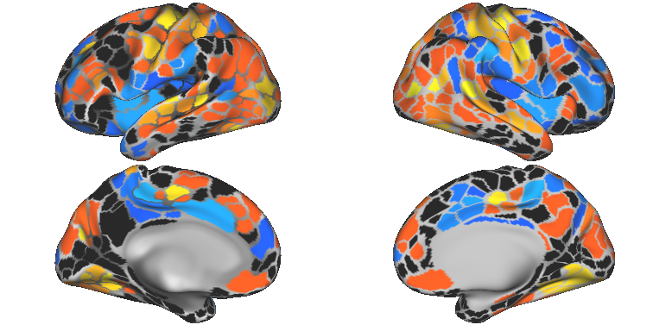
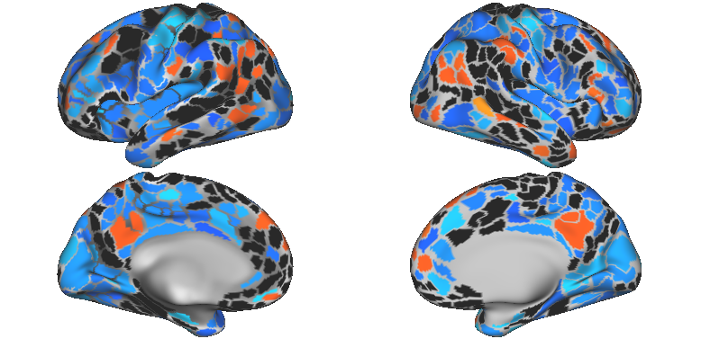
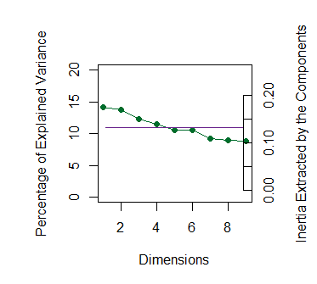
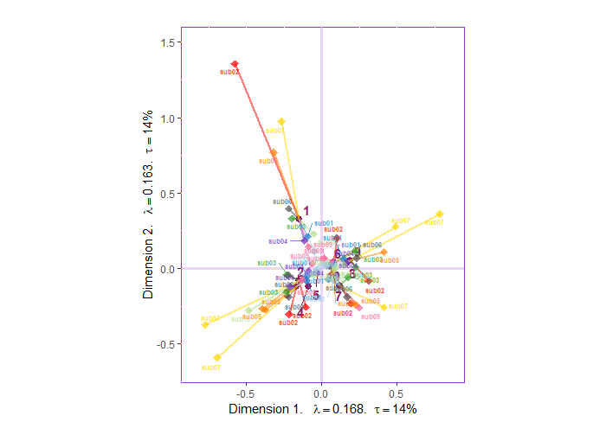
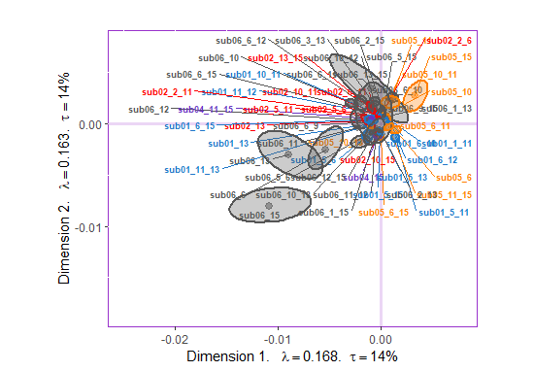
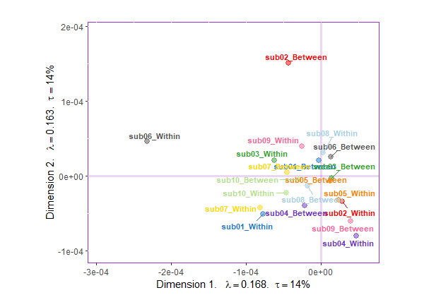
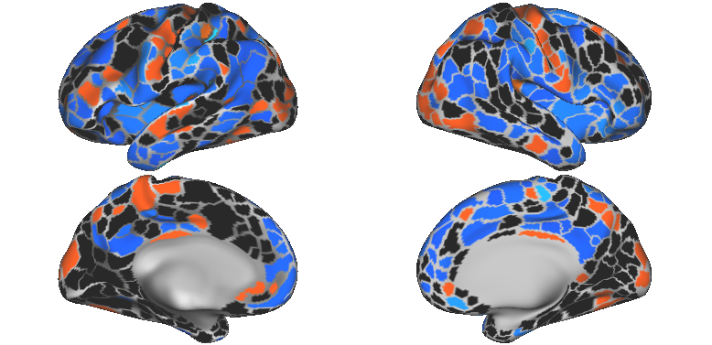
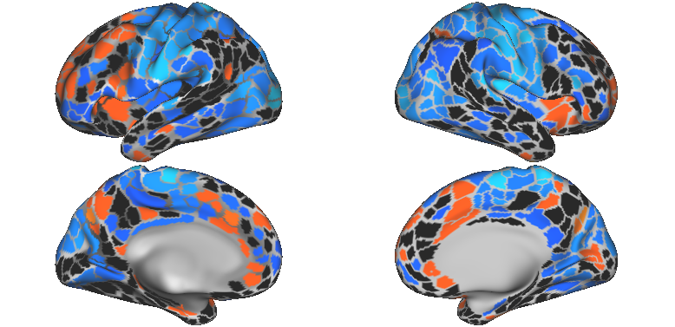
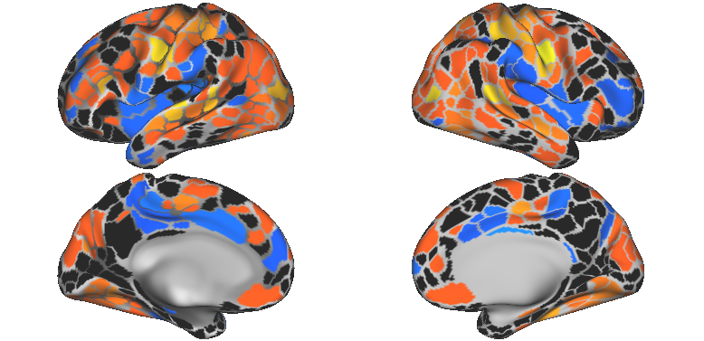
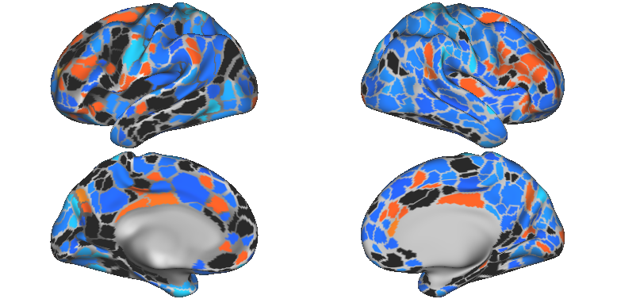
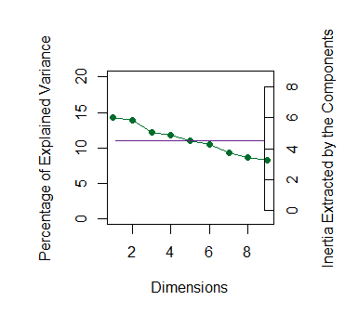
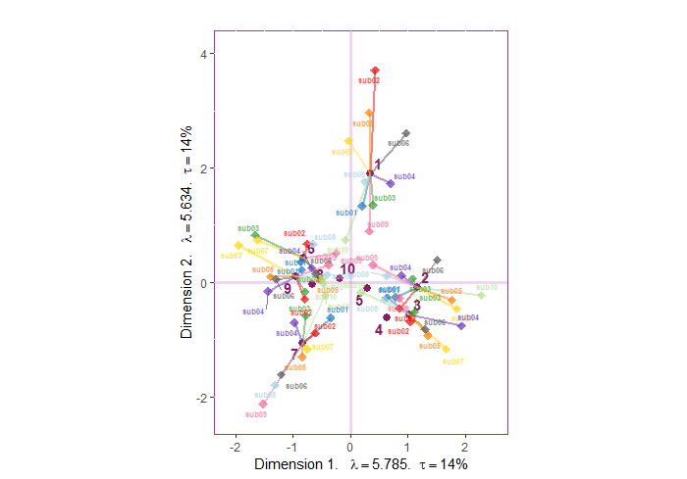
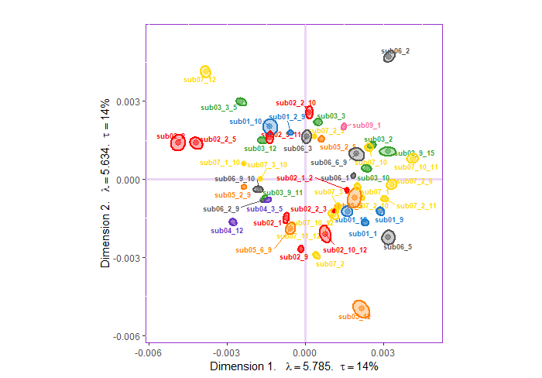
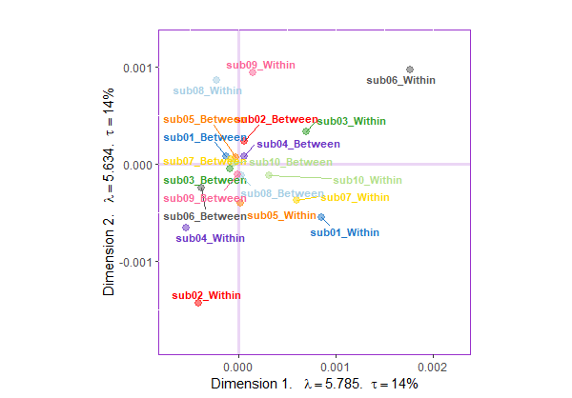
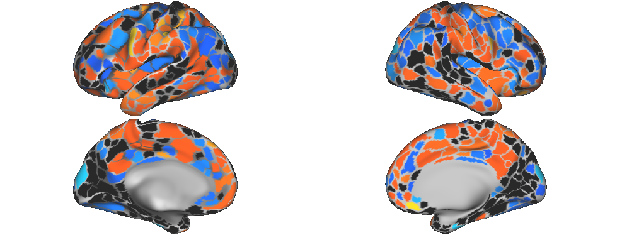
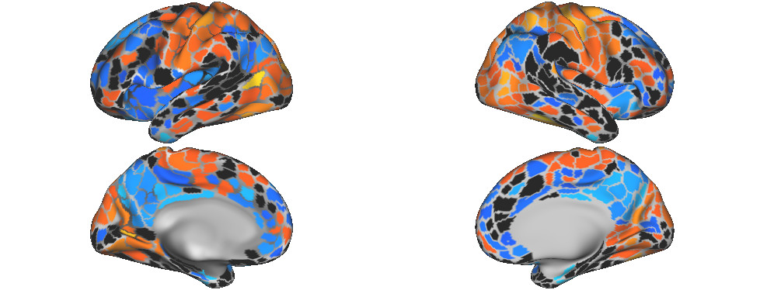
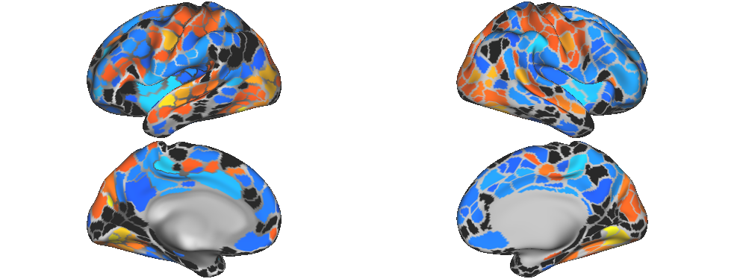
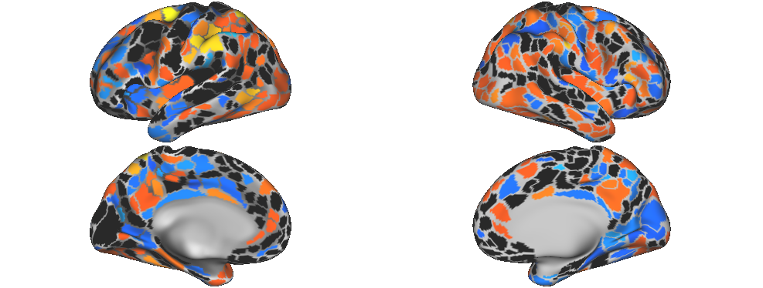
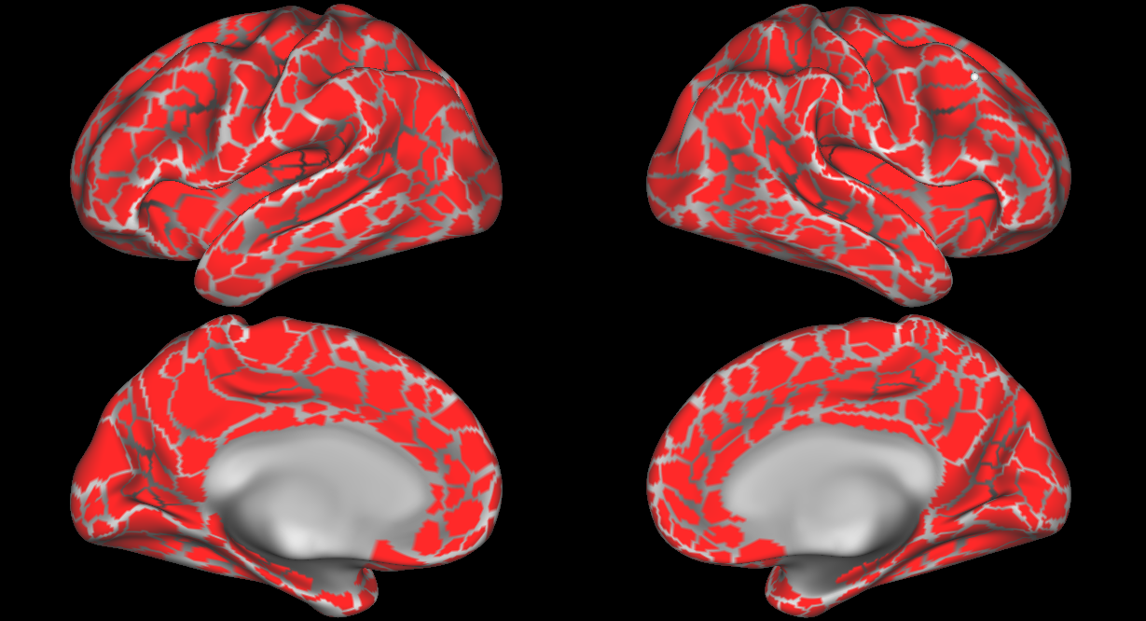
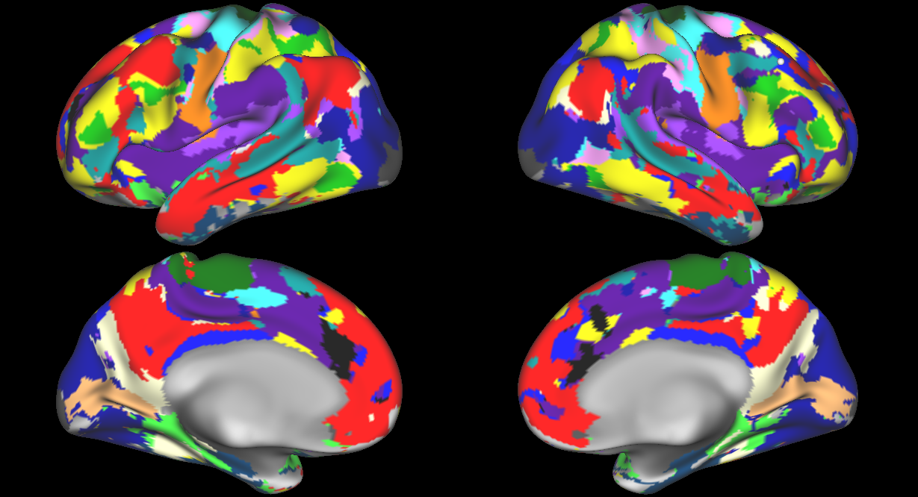
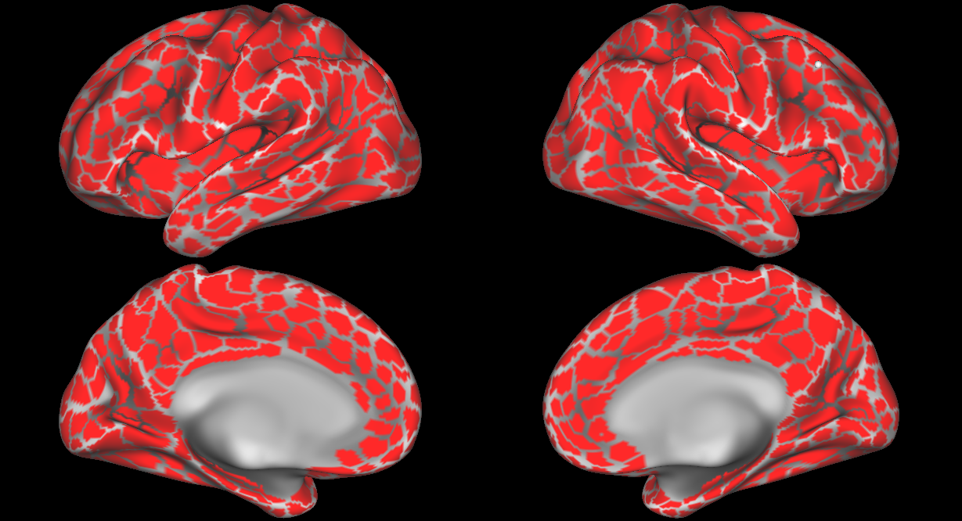
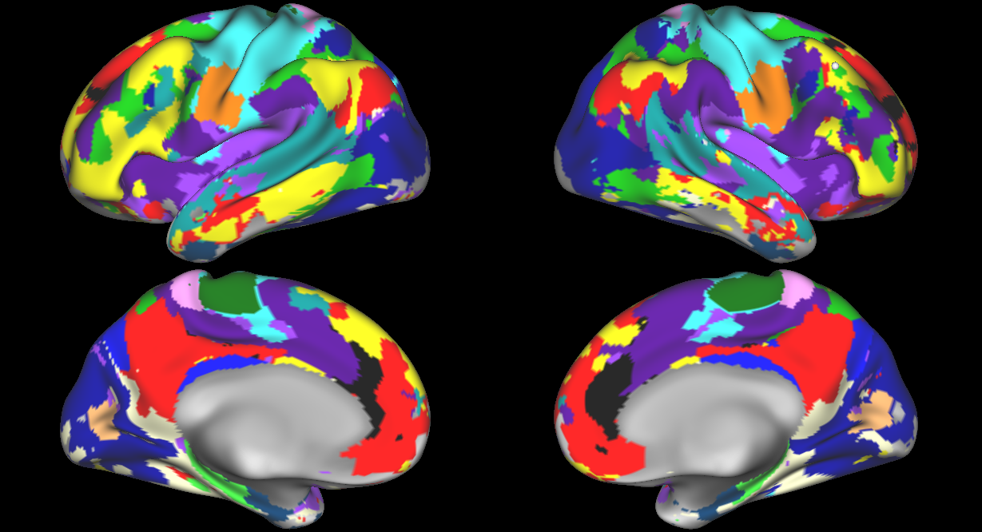
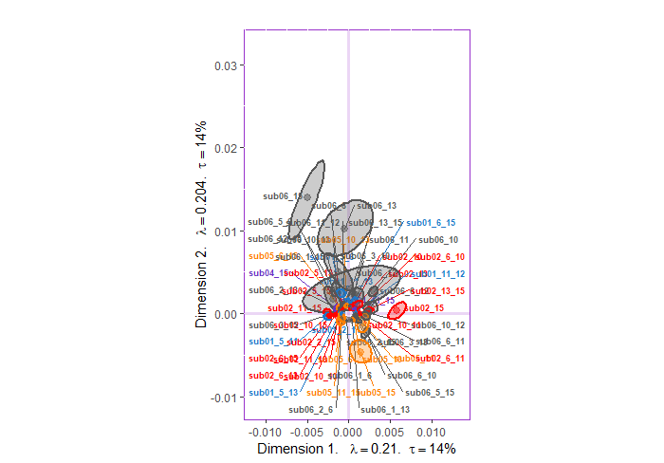

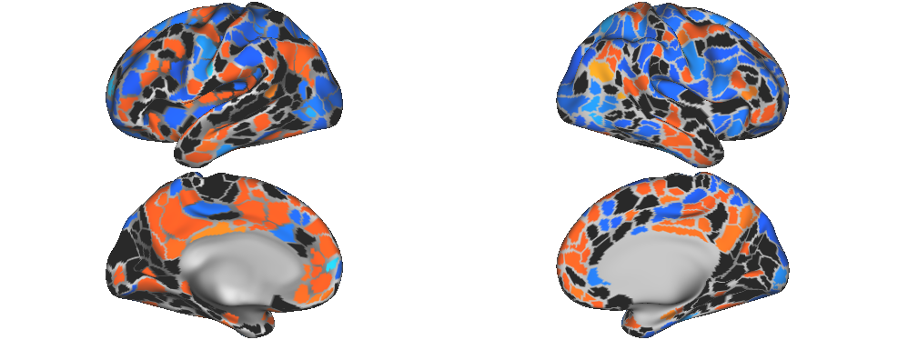
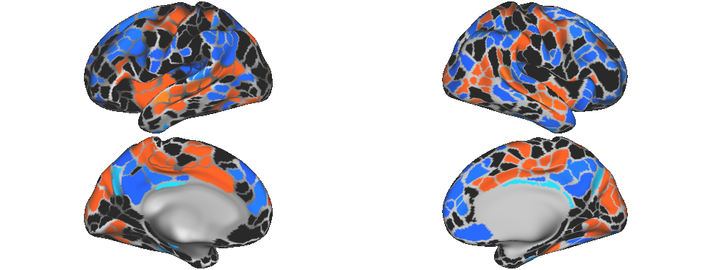
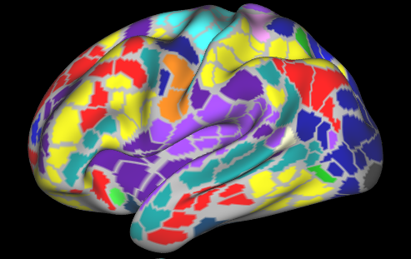
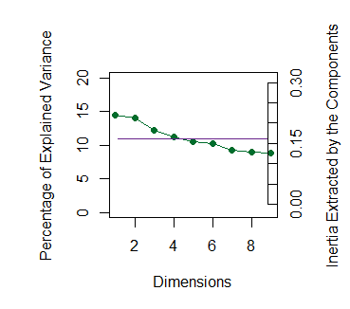
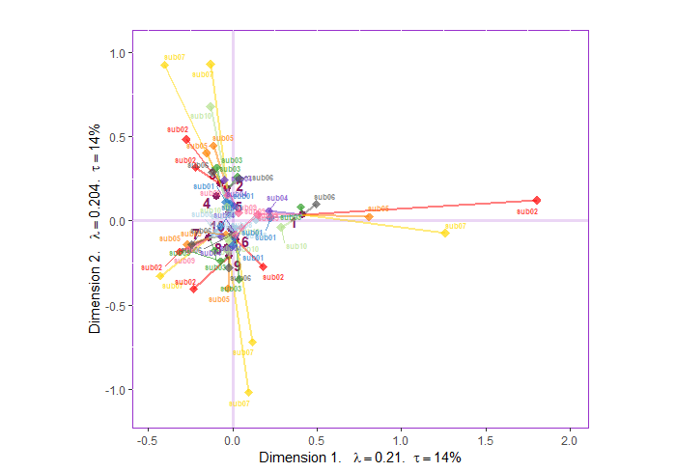
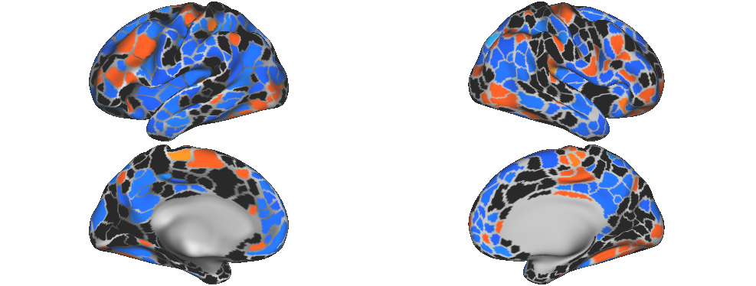
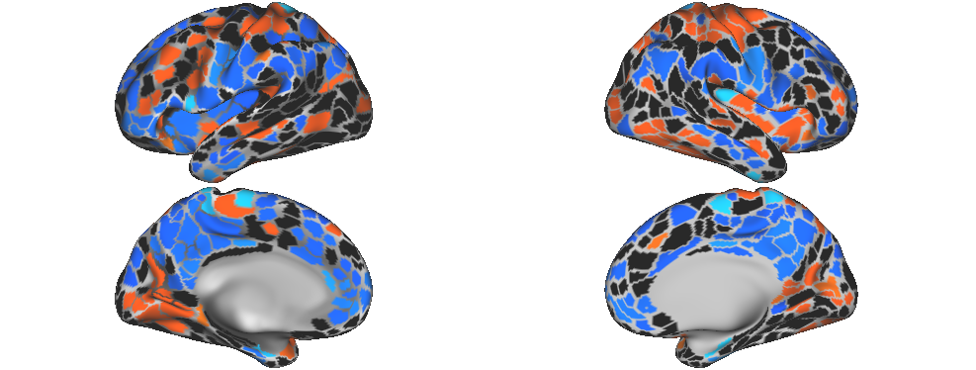
A multivariate resting-state fMRI technique for subject-specific parcels and sub-networks
Ju-Chi Yu¹, Micaela Chan^{1,2}, Han Liang^{1,2} & Hervé Abdi¹
1. School of Behavior and Brain Sciences, the University of Texas at Dallas; 2. Center of Vital Longevity, the University of Texas at Dallas
Ju-Chi.Yu@utdallas.edu, mchan@utdallas.edu, Liang.Han@utdallas.edu, herve@utdallas.edu
1. Introduction
3. Examples of connectivity matrices
4. Proposed method
Background
Recent work in resting-state fMRI (rsfMRI) analysis can derive subject-specific parcellations and sub-networks.
Standard approaches for rsfMRI:
Graph/network analysis accommodates different numbers of parcels/sub-networks.
Requires correction for multiple comparisons when examining sub-networks.
Multivariate analysis (e.g., MDS, DISTATIS) requires the same number of parcels/sub-networks.
Usually achieved by using a shared template.
Biases against individuals that vary greater from the target template.
The above issues from standard approaches are particularly problematic for studies involving subjects that exhibit larger variance in brain structure and function (e.g., elderly, lesion patients, children).
Aim
To develop a new multivariate technique that allows different numbers of parcels and sub-networks.
MSC01 (Sessions 1-5)
Session 1
Centering: exclude the effect of magnitudes
Double-centering the z matrix: exclude the magnitudes of regions
Normalization: exclude units
MFA-normalization (divide each table by its first singular value): equalize contributions of tables to the first component.
Session 2
…
…
…
…
MSC07 (Sessions 1-5)
Session 10
…
…
…
…
Common Sub-networks
…...
Preprocessed
Default
Visual
Frontal-parietal control
Dorsal Attention
Ventral attention
Cingulo-opercular control
Hand somato-motor
Mouth somato-motor
Auditory
Subj 1
Subj 2
Subj 3
Subj N
Common networks across participants were selected for the analysis.
Negative and perfect z-transformed correlations were excluded from further analysis.
Session 1
Session 2
Scale
…
SVD
Session 10
5. Choices of preprocessing steps
6. Results
 | Dimensions | Preprocessing | Aims
1 | z-matrices | x | To exclude: Mean magnitudes of edges To equalize: The contributions of subjects
 | rows | x
 | columns | centered
 | edge tables | x
 | subject tables | MFA-normalized
2 | z-matrices | x | To exclude: Mean magnitudes of edges To equalize: First the contributions of edges Second the contributions of subjects
 | rows | x
 | columns | centered
 | edge tables | HMFA-normalized (edge → subject)
 | subject tables
3 | z-matrices | double-centered | To exclude: Mean magnitudes of regions Mean magnitudes of edges To equalize: The contributions of subjects
 | rows | x
 | columns | centered
 | edge tables | x
 | subject tables | MFA-normalized
4 | z-matrices | x | To exclude: Mean magnitudes of regions Mean magnitudes of edges To equalize: First the contributions of edges Second the contributions of subjects
 | rows | x
 | columns | centered
 | edge tables | HMFA-normalized (edge → subject)
 | subject tables
Scree plots
Factor scores for sessions and edges
Aggregated factor scores for nodes (between and within combined)
Analysis #1
MSC07
Dimension 1
MSC10
Dimension 1
Analysis #2
MSC02
Dimension 2
MSC09
Dimension 2
MSC06
Dimension 1
MSC07
Dimension 1
2. Resting-state data set
MSC02
Dimension 2
MSC04
Dimension 2
Midnight Scan Club (MSC; Gordon et al, 2017)
Resting-state fMRI (30 minutes)
10 participants x 10 sessions
Subject-specific parcellations and sub-networks
Analysis #3
MSC06
Dimension 1
MSC07
Dimension 1
Parcellation
Sub-networks
Parcellation
Sub-networks
Justifications and thoughts
Normalizations were not applied to rows or columns because their units are the same.
The rows were unprocessed because we want to apply this technique to data where the differences in both magnitudes and variances of rows are of interest (e.g., experiments).
The choices of these preprocessing steps should be optional and decided based on the research question.
MSC02
Dimension 2
MSC09
Dimension 2
MSC01
MSC07
Analysis #4
Parcel’s mean time series during resting-state scan
Cross correlation between parcels
MSC01
Dimension 1
MSC02
Dimension 1
Fisher’s Z transformation
Frames
Extract time series and create correlation matrix for each session of each subject
MSC06
Dimension 2
MSC07
Dimension 2

Slide 2

Session 1
Subj 1
Subj 2
Subj 3
…...
Subj N
Session 2
…
Session 10
Session 1
Session 2
…
…
…
…
Session 10
…
…
…
…

Slide 3
Session 1
Subj 1
Subj 2
Subj 3
…...
Subj N
Session 1
Subj 1
Subj 2
Subj 3
…...
Subj N
Session 2
Session 2
…
…
Session 10
Session 10
Session 1
Session 2
…
…
…..
…
…
Session 10

